Slide 1


Slide 2

Computer Vision (CV)
Lab1
Introduction

Slide 3
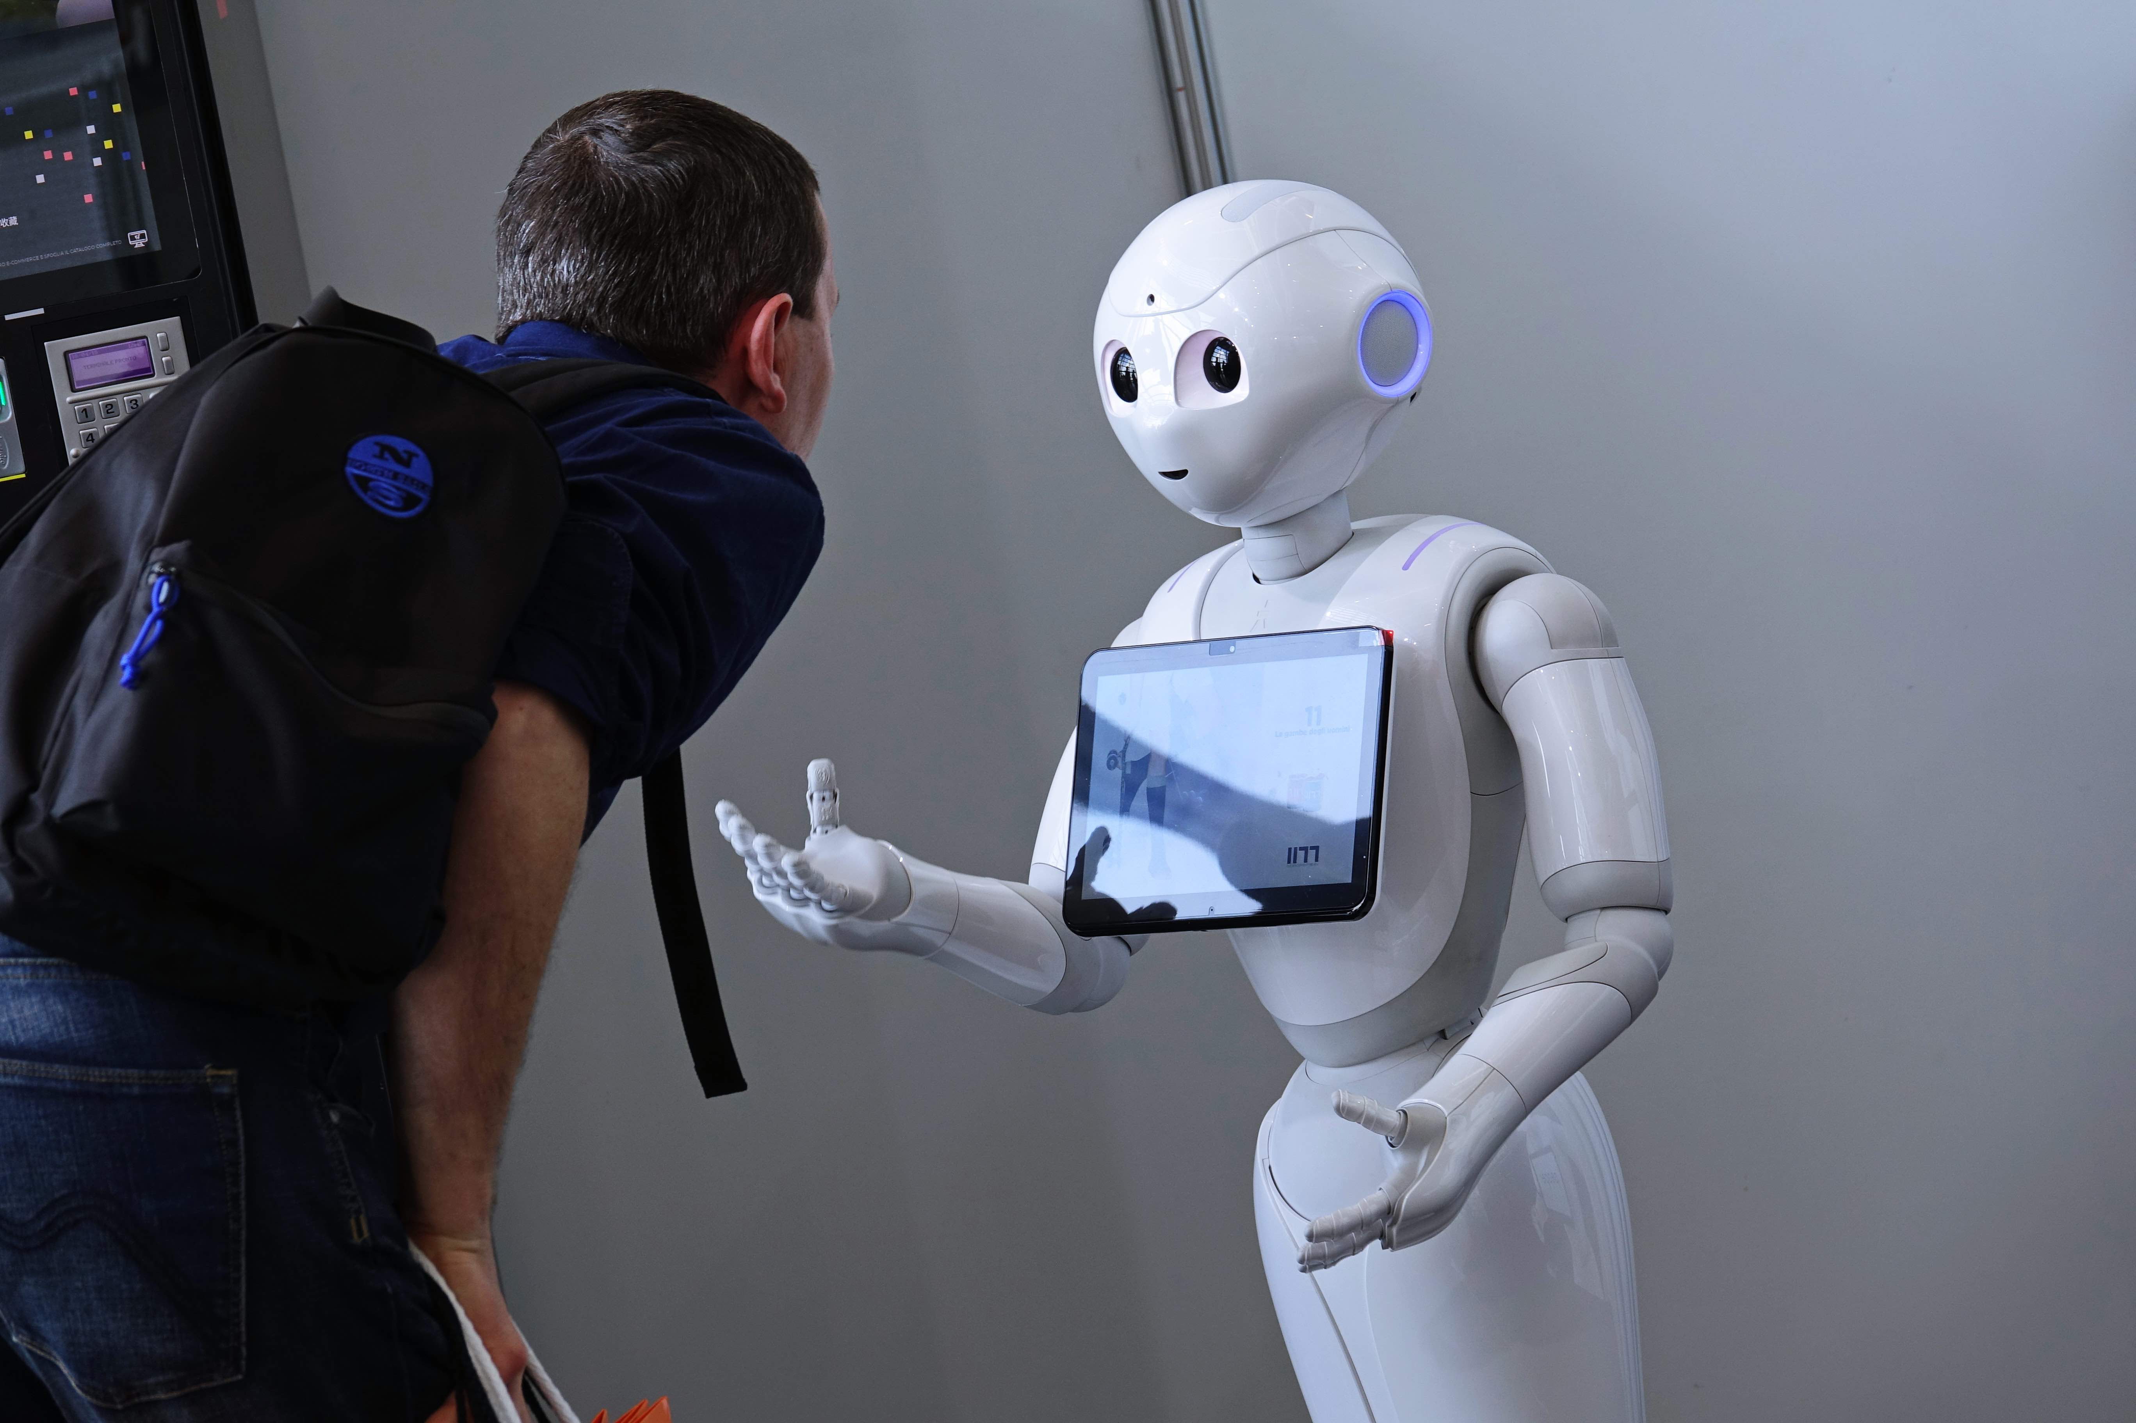
Computer Vision (CV)
CV is focuses on enabling computers to extract information and identify objects from images and videos, in a manner like human vision.

Slide 4
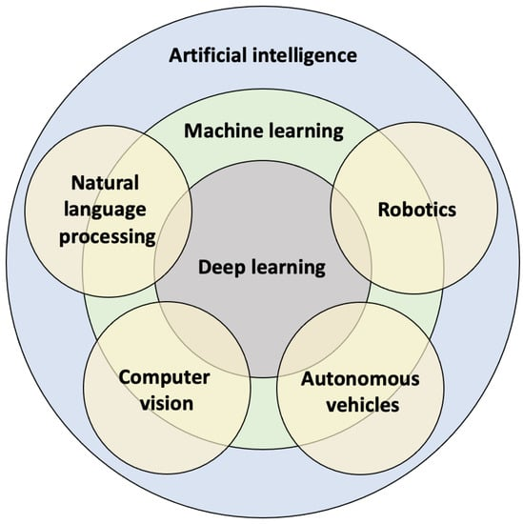
Computer Vision (CV)
CV is a field of study within artificial intelligence (AI).

Slide 5
Course Plan (Lab)
Week | Topic
1 | Intro + image Processing with opencv
2 | Feature Extraction + Machine Leaning
3 | Deep Learning (CNN)
4 | Transfer Learning + Auto encoder
5 | Introduction Object detection + Yolov8 & 9 & Yolo World
6 | Tracking Yolov8 &9
7 | Segmentation Unet + Yolov8
8 | Pose Estimation
9 | Optical Character Recognition (OCR)
10 | Face detection + Face Recognition

Slide 6
Grading
Lab attendance | 8 Marks
Lab work | 7 Marks
Final project | 10 Marks
Total | 25

Slide 7
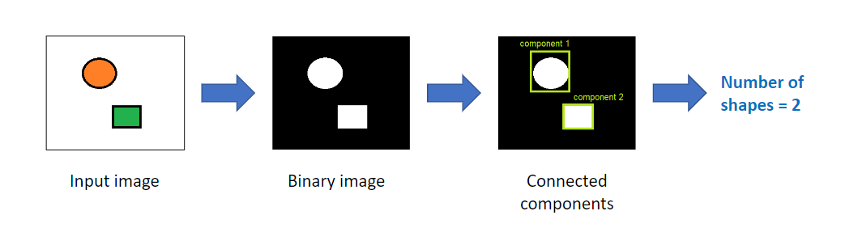
Computer vision techniques
1. Image Processing

Slide 8
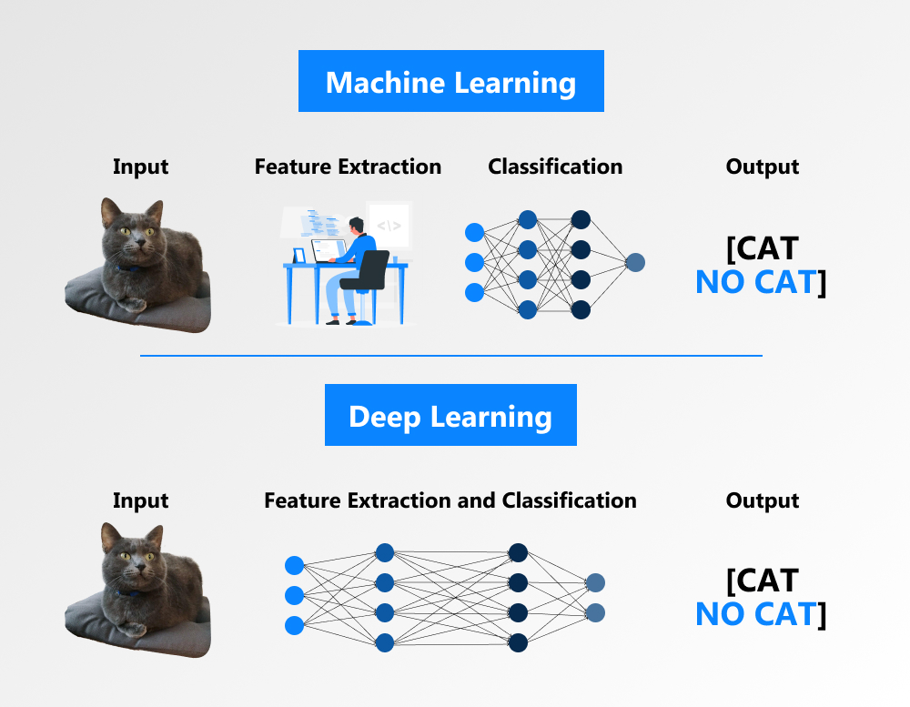
Computer vision techniques
2. Feature extraction + Machine Learning
Data vector

Slide 9
Computer vision techniques
3. Deep Learning

Slide 10
Machine Leaning VS Deep Learning
Data vector
Machine Leaning
Deep Learning

Slide 11
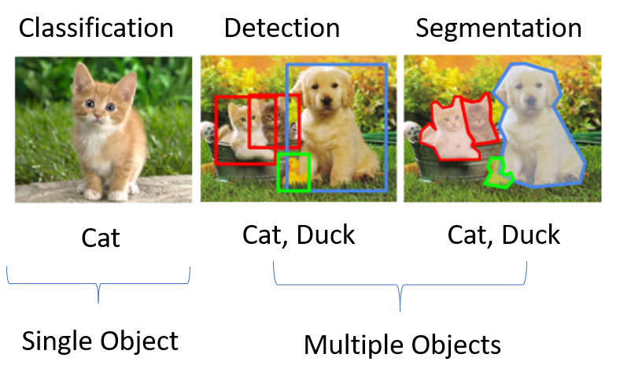
Computer vision fields
1. Image Classification
2. Object detection
3. Image segmentation

Slide 12
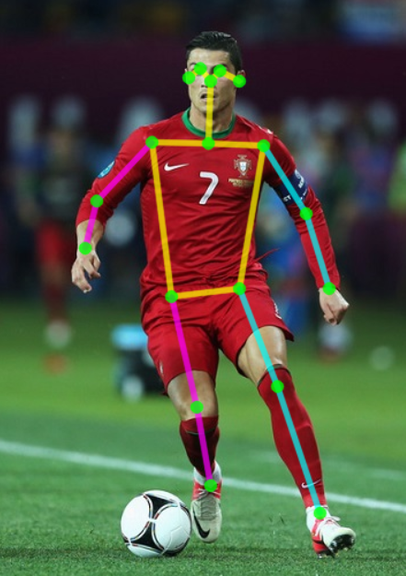
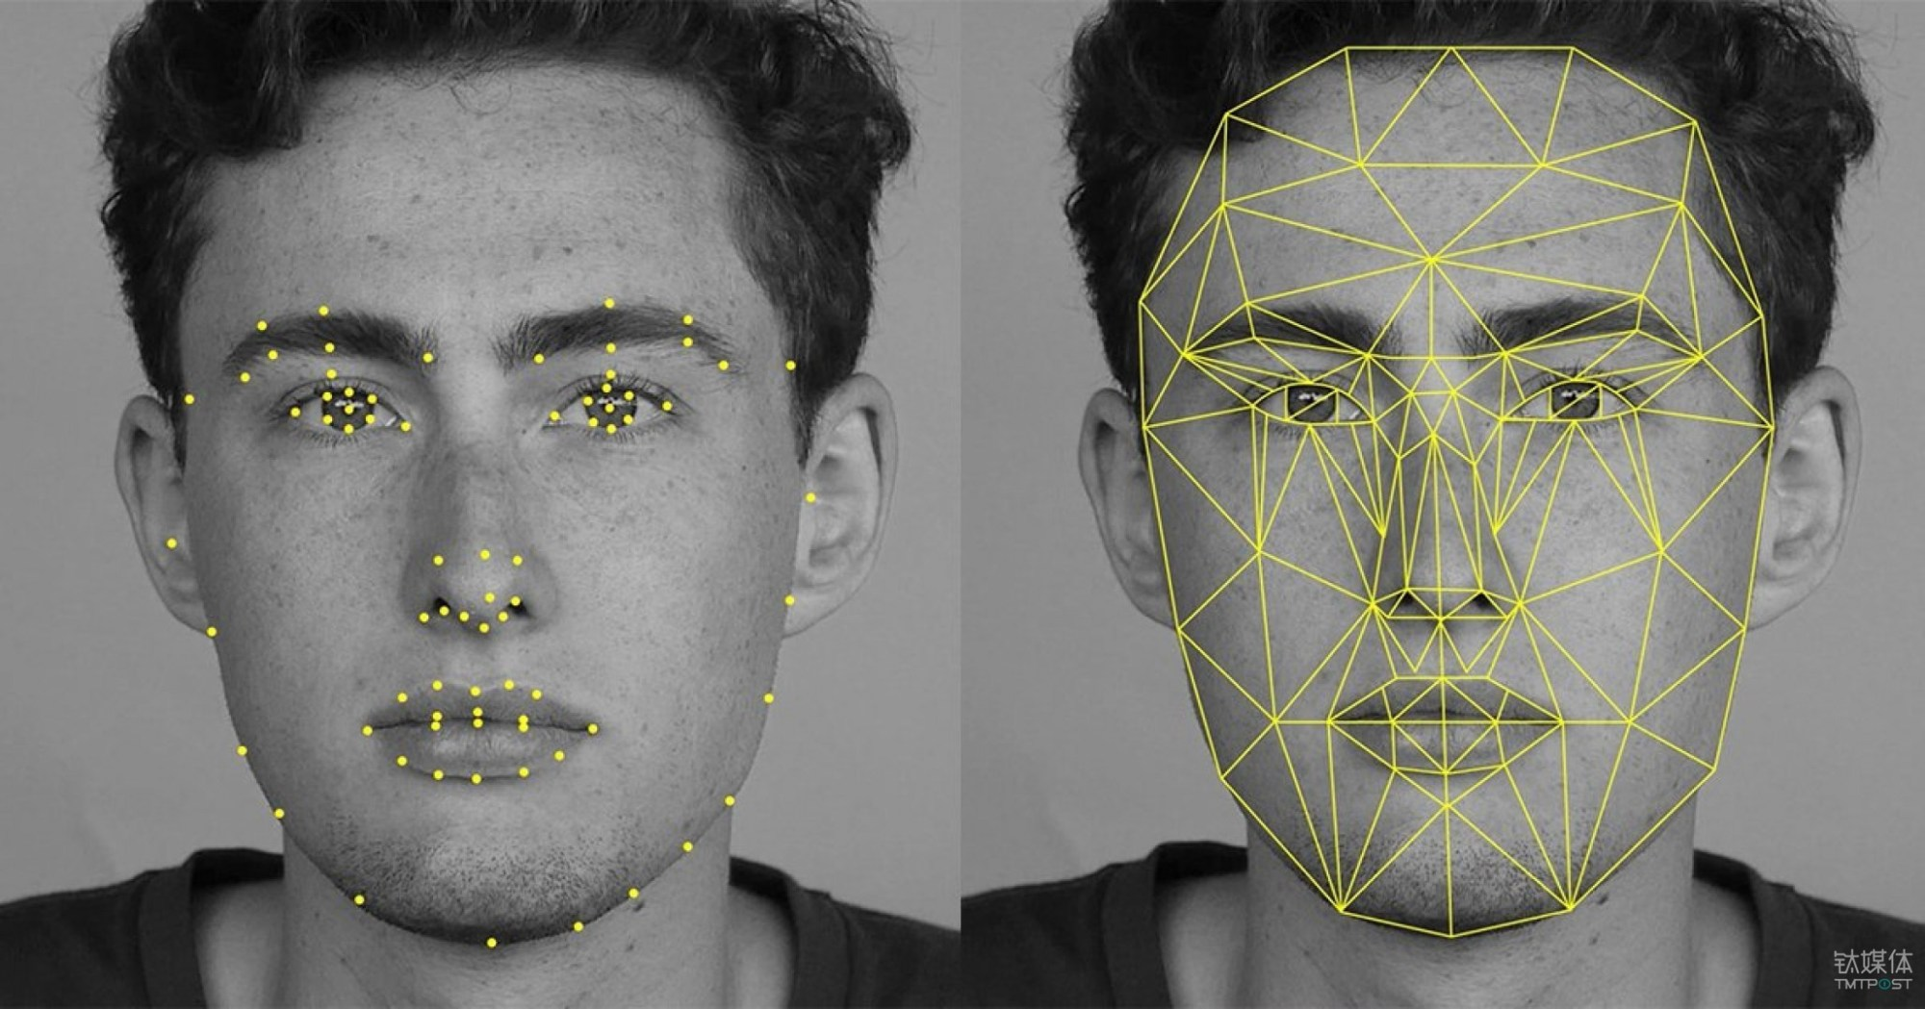
Computer vision fields
Pose Estimation

Slide 13
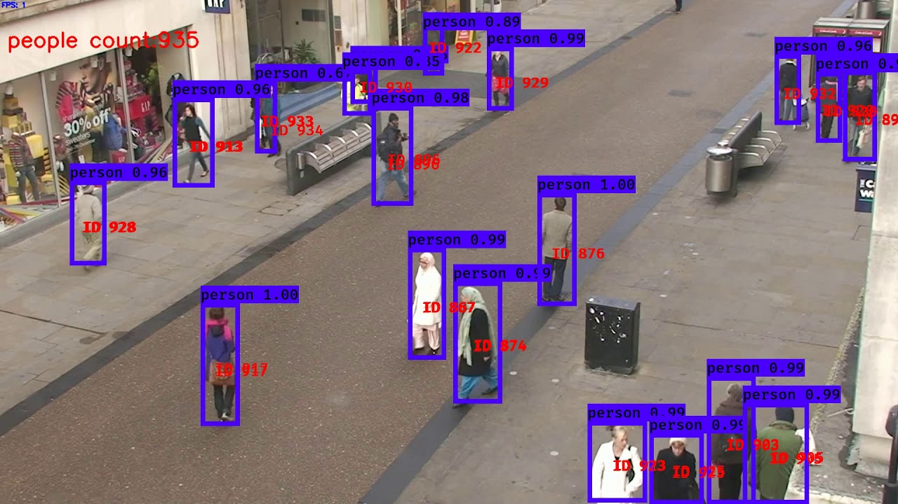
Computer vision fields
Tracking

Slide 14
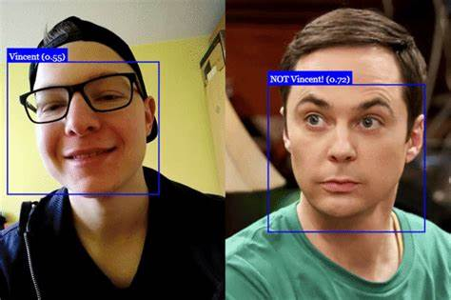
Computer vision fields
Face Detection
Face recognition

Slide 15
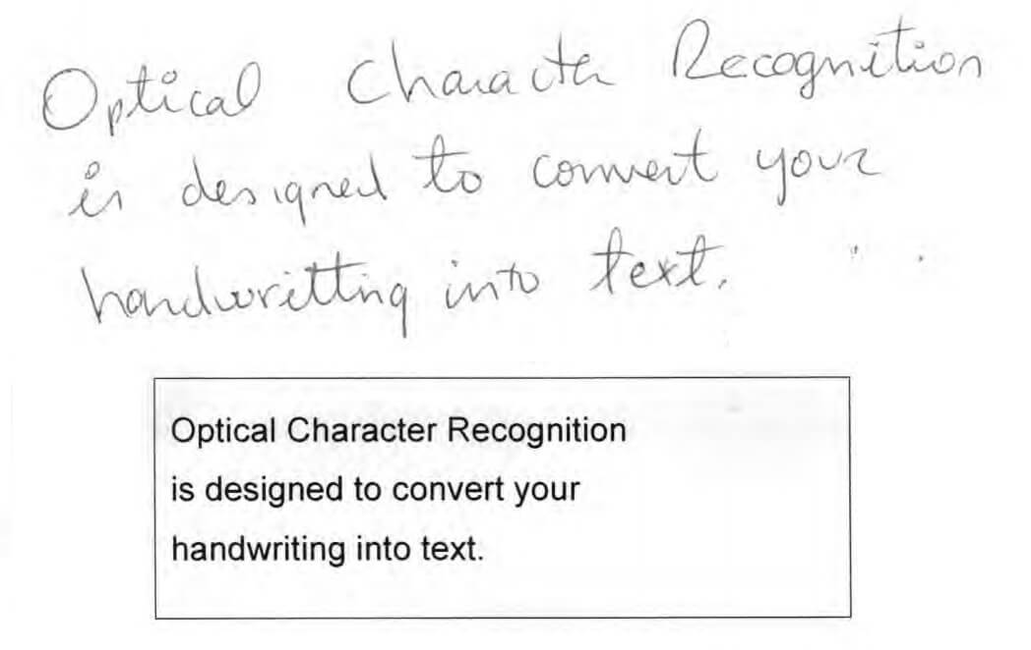
Computer vision fields
Optical Character Recognition

Slide 16

Anaconda
Download from here: https://www.anaconda.com/download

Slide 17
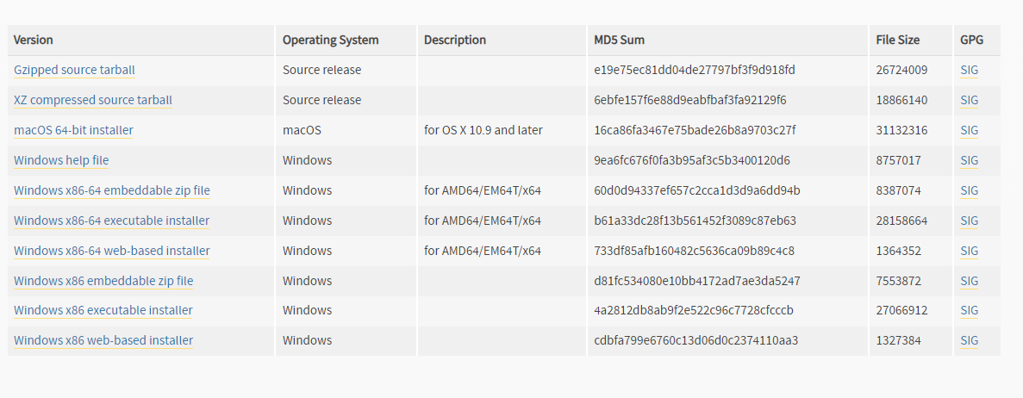
Python
Download from here: https://www.python.org/downloads/release/python-390/

Slide 18

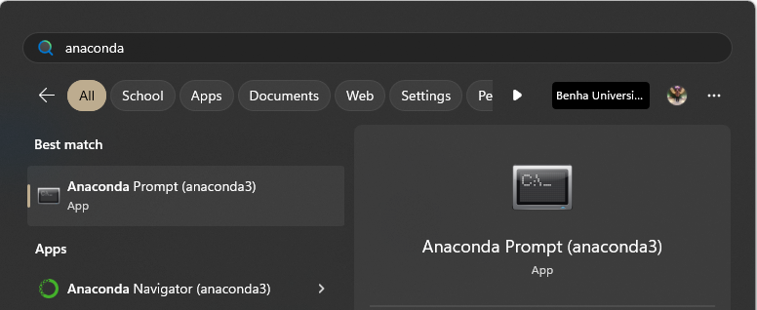
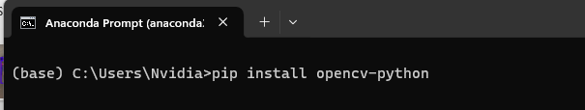
OpenCV
OpenCV (Open-Source Computer Vision Library) is a library of programming functions mainly for real-time computer vision.
Download from here: https://pypi.org/project/opencv-python/
pip install opencv-python
Documentation: OpenCV - Open Computer Vision Library

